Slide 1
NTU Real-Time Bus ID Verification and Tracking
Presented by: FYP-24-SE-A-04
Supervisor: Sir Zahid Javed

Slide 2
Table of Contents
Problem Statement
Proposed Solution
Key Features
Real-Time ID Verification
Live GPS Tracking
Overcrowding and Underutilization Alerts
Driver Efficiency Monitoring
Technology Stack
Expected Outcomes
Conclusion

Slide 3
1. Problem Statement
The current bus system at NTU suffers from significant inefficiencies and security concerns. Students are boarding buses without proper verification, resulting in overcrowding, unauthorized access, and unfair usage by those who have not paid the necessary transportation fees.
The absence of real-time ID verification and bus tracking is a major problem. Administrators, students, and parents have no real-time visibility of bus locations, and there is no effective way to track driver performance. As a result, buses are often overcrowded or underutilized, which leads to inefficiencies and discomfort for students.
In addition, the current communication system is inadequate. Updates regarding transport schedules, route changes, or delays are not effectively communicated to students and parents, which creates confusion and poor management of bus capacity.

Slide 4
2. Proposed Solution
The proposed solution aims to automate the process of bus ID verification and tracking by using RFID technology. The system will employ RFID cards and readers to verify student identity in real-time. This will ensure that only authorized students can board the bus, preventing misuse by unauthorized users.
In addition to RFID verification, the system will provide live GPS tracking for buses. This will enable students, parents, and administrators to track bus locations in real-time, improving transparency and allowing for better route and schedule management.
The system will also monitor bus occupancy and driver performance, providing data on overcrowding, underutilization, and driver efficiency. This data will help administrators optimize bus routes and schedules. Furthermore, a mobile application will be developed to communicate important transport updates and notifications to students and parents, ensuring real-time information flow.

Slide 5
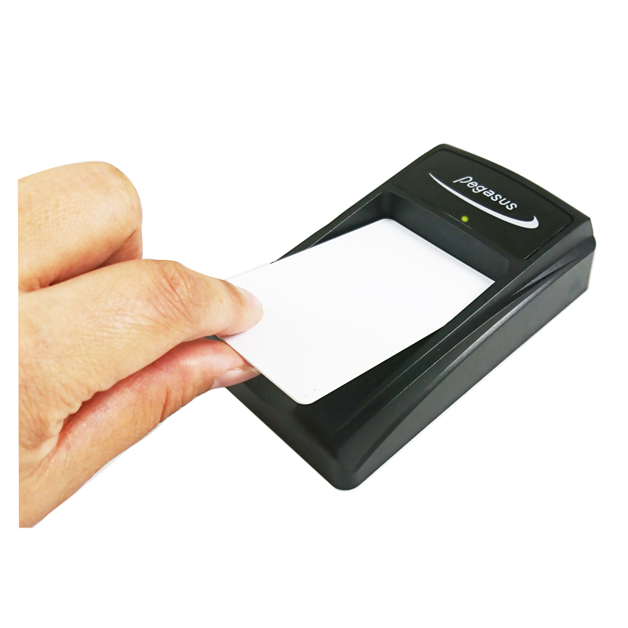
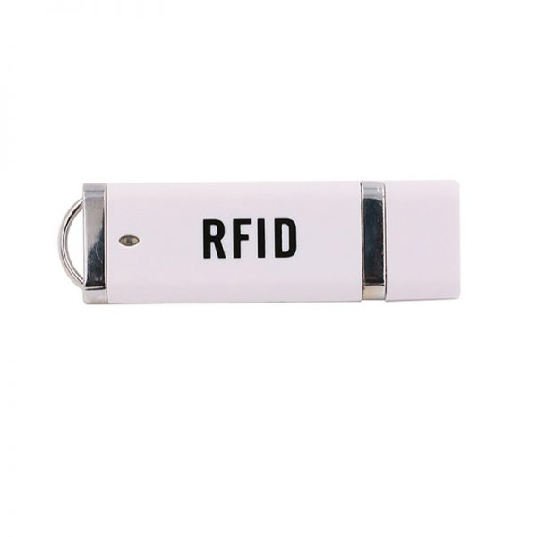
3. Key Features
The proposed system is designed with several key features to enhance the overall transportation management:
Real-Time ID Verification:
The system will use RFID technology to ensure that only authorized students can board the bus. RFID cards will be scanned in real-time, preventing unauthorized access and ensuring that fare-paying students can use the service.

Slide 6
Live GPS Tracking:
Real-time tracking of buses will be available for students, parents, and administrators, providing accurate bus locations and enabling better planning and safety monitoring.
Overcrowding and Underutilization Alerts:
The system will monitor the number of students on each bus and send alerts when buses are overcrowded or underutilized. This will help administrators optimize bus capacity and scheduling.
Driver Efficiency Monitoring:
The system will track driver speed, stop intervals, and overall journey times, allowing for performance evaluation and route optimization.

Slide 7
4. Technology Stack
The system will leverage a modern and scalable technology stack to ensure efficiency and reliability:
1. Firebase: Real-time data synchronization, user authentication, and cloud storage for seamless operation.
2. Next.js: To build a dynamic and responsive admin panel for managing routes, bus occupancy, and driver performance.
3. Flutter: For mobile application development, ensuring cross-platform compatibility on Android devices.
4. RFID Readers and Cards: For real-time student ID verification, enabling secure and efficient access to the transport system.
5. GPS and Mapping Technologies: Using Google Maps and MapBox for accurate live mapping, route tracking of buses and turf js to alert the management if bus goes off route.

Slide 8
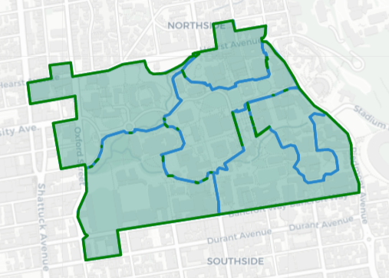
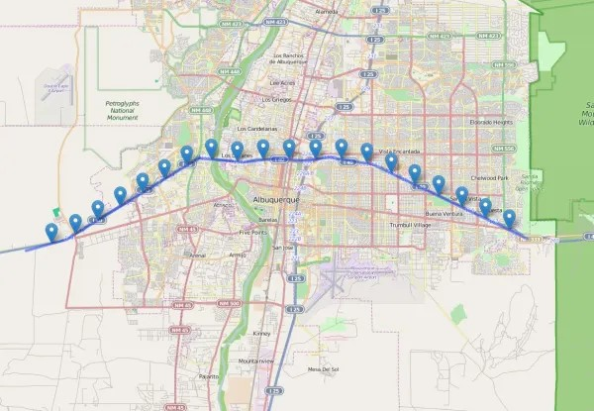

Slide 9
5. Expected Outcomes
The successful implementation of this project is expected to deliver the following outcomes:
Enhanced security through real-time RFID student ID verification, preventing unauthorized access to buses.
Optimized bus capacity management by reducing overcrowding and preventing underutilization.
Improved communication with students and parents, ensuring they are informed about transport delays or route changes in real-time.
Increased efficiency in transportation operations through live GPS tracking and driver performance monitoring.
Greater transparency and control for university administrators, allowing for better route and schedule planning.

Slide 10
6. Conclusion
The NTU Real-Time Bus ID Verification and Tracking system will revolutionize the university's transportation management. By integrating RFID-based verification, real-time bus tracking, and effective communication channels, the system will enhance safety, optimize bus usage, and improve overall operational efficiency. The project will address all existing challenges in the current system, providing a secure, transparent, and responsive solution that benefits students, parents, and administrators alike.

